Slide 1
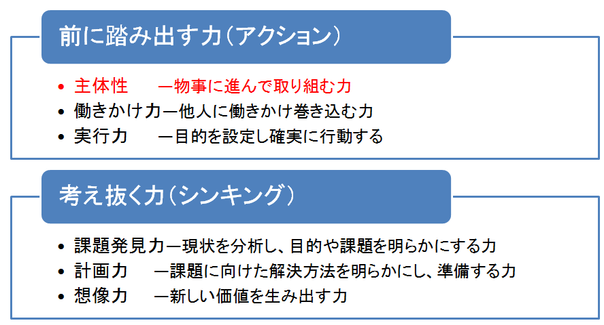
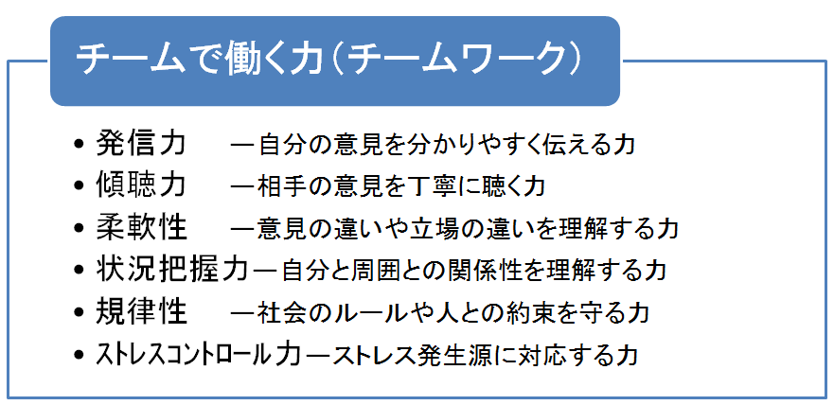
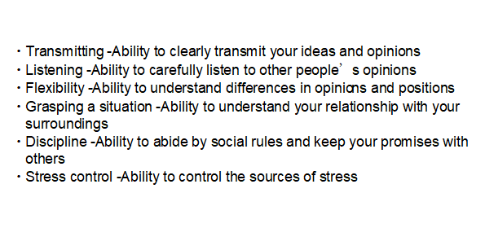
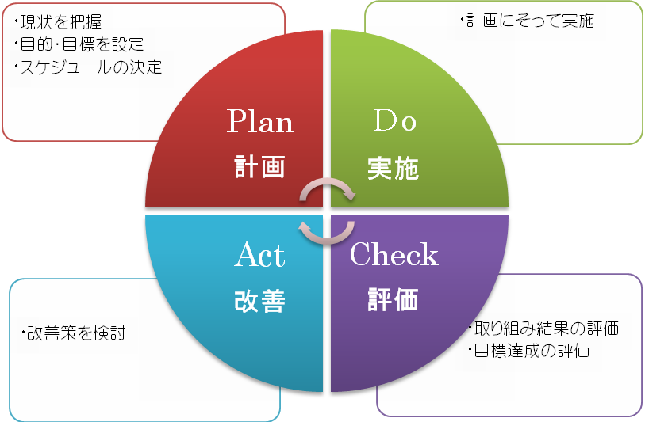
Career DesignsⅠ：Lesson11～Scheduling Skills～
1. Equip yourself with basic abilities as a member of society.
2. PDCAサイクルで目標達成
How to P
How to D
How to C
How to A
※ Process management examples to design P and D
By when
Who？ With whom？ （Simulate who will be involved.）
What will you do？
How will you do？
How much will it cost？

Slide 2
3. Work: ‘Redesign’ your goals in university life
P: What were your thoughts, resolutions,
and objectives when you entered the
university?
What kind of university student do you
want to be?
D: How is your actual situation?
Plan
Do
Action
Check
C: What would you like to improve
about yourself?
What kind of abilities will you
equip yourself with?
What kind of attitude and mindset
do you think you should have?
(It is OK if the first step is small.)
A: What are you conscious
of acting?
4. Work: Declare your re-designed goal again.
Goal theme：
By when：
Necessary resources (skills, required personnel, capital, information, etc.)：
Possible challenges：
Specific execution methods：

