Slide 1
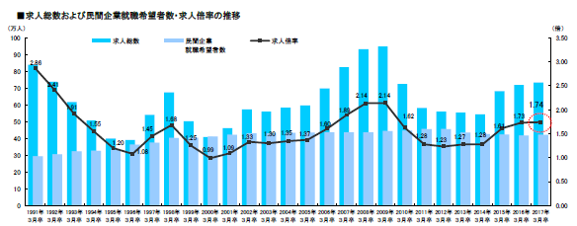
Career DesignⅠ：Lesson6～Society is waiting for you.～
Footsteps of Japan
●First Stage: Post-war turmoil and recovery from poverty (Japan: Miracle in Asia)
●Second Stage: High economic growth –bubble economy (Japan as No.1)
●Third Stage: Bubble economy bursts, the Great Hanshin-Awaji Earthquake, Lehman shock, the Great
East Japan Earthquake (Lost Two Decades)
●Fourth Stage: Overcoming deflation, new industry creation, globalization (Era of uncertain future)
①
First Stage: Post-war turmoil and recovery from poverty (Japan: Miracle in Asia)
Post-war situations:
・Food production could not sustain Japan’s population of 72 million
・There were not enough fibers for clothes.
・There were not enough raw materials, oil and steel.
・The production level was not high enough to meet the overpopulation demands.
・There was only manpower, coal and water.
Conditions:
・There was no need to spend a lot of money on defense
because the US acted, and continues to act, as Japan’s
protector.
・As most of the population was born and raised in Japan,
the country did not need to spend a lot of energy on
heterogeneity in language, religion, race and culture.
・The educational level in Japan was higher.
①Product Strategy
②Manufacturing Strategy
③Fund Strategy
④High Savings Rate
Second Stage: High economic growth –bubble economy (Japan as No.1)
※The Plaza Accord – Bubble Economy
↓The US struggled with ‘Twin Deficits (fiscal and trade deficits).
↓Strategic policy guidance from ‘a weak yen and strong dollar’ to a ‘strong
yen and weak dollar’ (The Plaza
Accord, 1985)
↓Recession caused by the high yen as exporting does not benefit firms.
↓The Bank of Japan lowered the bank rate in 1986, advocating ‘boosting
the economy by spending more money’ policy.
↓The flow of money into stocks and land
Third Stage: Bubble economy bursts, the Great Hanshin-Awaji Earthquake, Lehman Shock, the Great East Japan Earthquake (Lost Two Decades)
▼Number of job offers, job seekers for private sectors and job opening-to-application ratio
adapted from: Recruit Works Institute

Slide 2
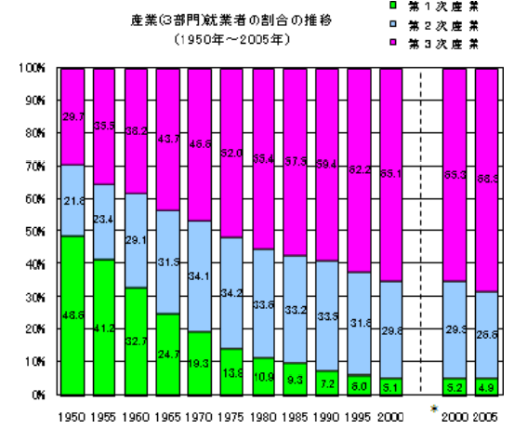
Changes in the numbers of workers employed in the three industrial sectors（1950-2005)
Primary Industry
Second Industry
Teritary Industry
Primary Industry: agriculture, forestry and fishery
Secondary Industry: construction and manufacturing
Tertiary Industry: infrastructure, communications, information, wholesaling, retailing, restaurant, financing,
services, education, etc.
(adopted from the website of the Statistics Bureau)
●Fourth Stage: Overcoming deflation, new industry creation, globalization (Era of uncertain future)
●Abilities necessary for work
●Understanding social changes
Growing society *What kind of abilities are required in a growing society?
↑
in the 1990s
↓
Mature society *What kind of abilities are required in a mature society?
●What would you choose, A or B?
●Four skills you would like to equip yourself with in your early twenties (proposal)
①
②
③
④

