Slide 1
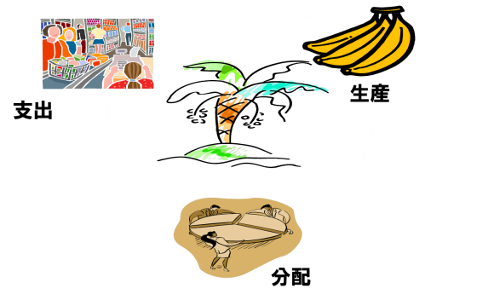
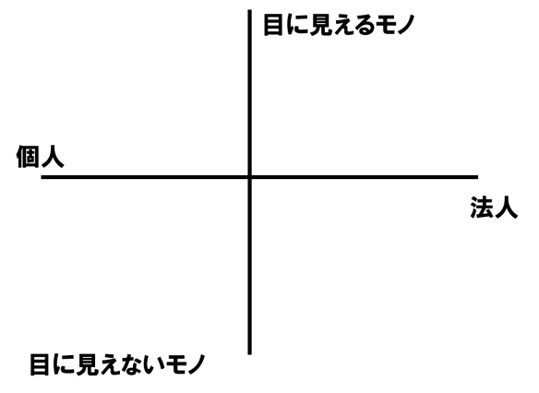
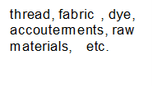
Career DesignⅠ：Lesson7～How society works. ① ～
1. About GDP and line of business
What is Gross Domestic Product (GDP)?
About 512 trillion yen (2007)
About 471 trillion yen (2009)
About 470 trillion yen (2011)
About 488 trillion yen (2014)
*IMF－World Economic Outlook Databases (October edition, 2014)
Newly created items and services are called [ ].
Let’s understand the principle of equivalence of three aspects of national income.
Studying the types of industries！
In the case of clothes:
Invisible things
②Currency and labor
◆Functions of Currency
【 】
【 】
【 】
If seen from economic viewpoint【 】
If seen from exchange function【 】
◆Requirements for currency
●Easy to store and carry
●The value is kept before it is exchanged.
●Easy to distinguish between good and bad currencies
without specialized knowledge
●Being rare
●More widely accepted than the item to be exchanged
*from “The Company of Strangers: A Natural History of Economic Life” (Paul Seabright)

Slide 2
◆Let’s write down the opinions voiced in the group.
【 】
becomes unnecessary.
※Difference between regular workers and ‘freeter’ workers (working conditions)
 | regular workers | freeter | notes
Age | 15-65 | 15-34 | Over 35 years old who called ‘middle-aged freeter
Lifetime wages
Retirement allowance
Pension benefits
More disadvantages for part-time workers！
◆Considering the issue of ‘freeter’ from the viewpoint of social benefit maximization.
●
●
●
●
The writer only finds himself, only realizes himself, through his work; before his work exists, not only does he not know who he is, but he is nothing. He exists only as a function of the work;
[Cited from the English translation of Maurice Blanchot’s “Le Part Du Feu (The Work of Fire－Literature and the Right to Death) translated by Charlotte Mandell, published by Stanford University Press]
When replacing ‘writer’ with ‘person’, and ‘work’ with ‘labor’:
The [ ] only finds himself, only realizes himself, through his [ ]; before his [ ] exists, not only does he not know who he is, but he is nothing. He exists only as a function of the [ ].
[Cited from “Machiba no Gendai Shiso” (contemporary thoughts in town) written by Tatsuru Uchida)

