Slide 1
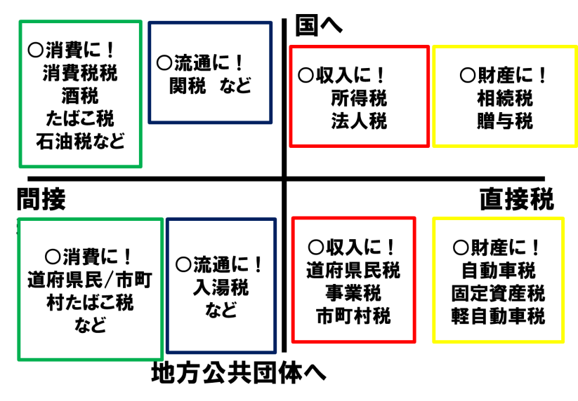
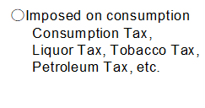
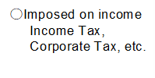
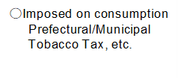
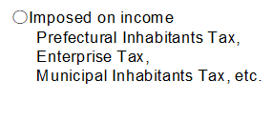
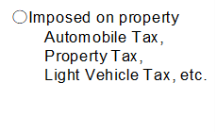
Career DesignⅠ：Lesson8～How society works. ② ～
Let’s consider tax.
Roles and types of tax
●Roles→【 】
●Types→
①To pay where？
②How to pay？
③On what is it imposed？
Let‛s think and discuss in a group. ① In which country do you prefer to live?
Country A | Country B
It doesn’t collect much tax. | More than half of the income is collected as tax.
You can obtain anything if you have the money and are willing to pay for it. | Necessary living coasts, such as food and transportation, are very cheep.
There are many good private schools, but the tuition fees are high. | Schools are public, and free until university.
You can choose the most suitable hospital from a choice of many, but all the medical expenses must be paid by individuals. | You have to wait for a long time to be seen by a doctor, but all the medical expenses are paid by the government.
You have to plan to save money for life after retirement. | You don’t have to save money as the government offers income and other help after retirement.
MEMO

Slide 2
Let‛s think and discuss in a group. ①②
Q1.Consider whether it is right or wrong to strongly urge individuals whose annual income is one billion yen to participate in social welfare activities and donations.
Q2. Consider what the problems are with Eleanor.
Eleanor was delighted with her new broadband connection. Having been used only to dial-up, she loved the fact that now her internet connection was always on, and also that surfing and downloading was so much quicker. And it was a bonus that it happened to be completely free. Well, to say it was free was perhaps a little misleading. Eleanor paid nothing for the service because she was using her neighbour's WiFi connection, otherwise known as a wireless Local Area Network. This enabled any computer within a limited range, as long as it had the right software and hardware, to connect without cables to a broadband internet connection. It so happened that Eleanor's apartment was close enough to her neighbour's for her to use his connection.
Eleanor didn't see this as theft. The neighbour had the connection anyway. And she was only using his excess bandwidth. In fact, a neat piece of software called Google Magpie made sure that her use of the connection never slowed her neighbour down by more than a negligible amount. So she got the benefit of his connection, but he didn't suffer as a result. What could be wrong with that?
－Cited from “The Pig That Wants to Be Eaten: 100 Experiments for the Armchair Philosopher “(Julian
Baggini)
Taxable Income (rounded down to the nearest 1,000 yen) | Tax Rate | Deduction (Unit: Yen)
Less than 1,950,000 | 5％ | 0
1,950,000－3,300,000 | 10％ | 97,500
3,300,000 －6,950,000 | 20％ | 427,500
6,950,000－9,000,000 | 23％ | 636,000
9,000,000－18,000,000 | 33％ | 1,536,000
Over 180,000,000 | 40％ | 2,796,000
Over 40,000,000 | 45％ | 4,796,000
Re. Income Tax Rate in Japan (after 2015)
経済＝経世済民＝Economics=Oikonomics=【 】
Career DesignⅠ Assignment for the next class
●List 100 good points about yourself.

