Slide 1
Career DesignⅠ：Lesson9～Self-formation ①～
The basic premises of Adlerian Psychology
①‘Man can change/ Anyone can be happy’
②About behavioral goals and psychological goals
〇Behavioral goals→(・to become independent ・live in harmony with society)
〇Psychological goals→(・recognition of being capable ・recognition that people are my source of
cooperation, not a competitor)
Work ①
■Discuss the assignment ‘List 100 good points about yourself’ in pairs.
■Write down your thoughts after exchanging the lists.
Let’s consider. ① Consider person- to- person relationships.
①Acknowledge the differences in personalities.
→
→
②To form a smooth, interpersonal relationship:
→Do not regard personal relationships in a competitive way. (If you don’t compete with others, you can
build a friendly relationship.)
→Do not regard a personal relationship as a power struggle.
Work ②: Examine the values that you currently have.
－What kind of things do you value and consider as important?
Check the boxes of the items you value.
’14 values people often consider as important’
□Utilization of abilities □Achievement □Seeking beauty □Altruism □Autonomy
□Creativity □Economic rewards □Lifestyle □Concrete activities
□Social recognition □Risk-taking □Social interaction □Diversity □Environment
※Among the items you chose, prioritize the top five and explain the reasons behind your choices.
1.
2.
3.
Work ③: Why have you obtained such values? Consider the reasons by examining your personal history.
※Recall significant memories of happiness, anger, sadness, achievement, setback, etc. in your past. Write down whatever comes to mind.
Age0 2 4 6 8 10 12 14 16 18 20 22
elementary school junior high school senio high school

Slide 2
Work ④:Review your personal history in Work ③, and recall
your most ‘glorious’ moment and why you consider it as such
b. your least ‘glorious’ moment and why you consider it as such
Talk about your most ‘glorious’ moment in pairs and then write about it.
Let’s consider ② ～Consider a harmonious relationship between the individual and society.
*What is lifestyle? →the style and nature of life as an individual
According to Adler:
〇Components of Lifestyle
・Self-concept →beliefs about oneself, “Who I am”
・World Image →beliefs about the current world situation, ‘〇〇〇is ×××’
※〇〇〇: the words ranging from your surroundings to the wider world.
×××: what you think (what you can view from your world image)
・Self-ideal →beliefs about the ideal of oneself and the world: ‘I want ○○ to be ××to me.’
Work ⑤: Write about your lifestyle.
 | Yourself | World
Present | Self-concepTop I am ～． | World Image ○○ is ××．
Ideal | Self-ideal I should be ～． ○○○ should be ｘｘｘｘ．

Slide 3
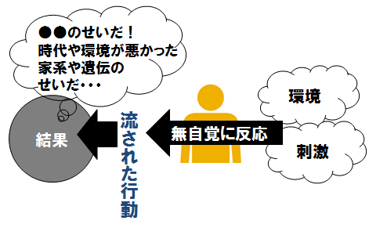
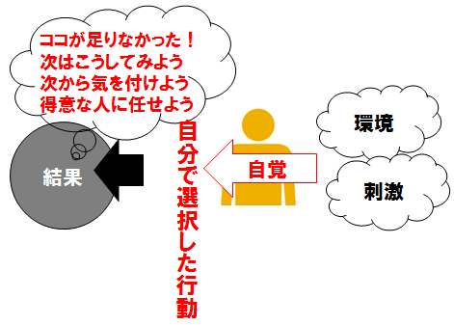
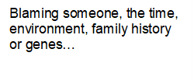
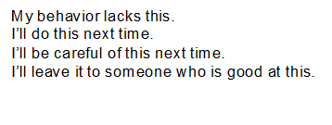
Let’s consider. ③ ～Consider self-acceptance.～
※What is self-acceptance?
→Accept yourself for who you are, including all your strengths and weaknesses. In other words, accept yourself as imperfect.
You are OK to be yourself as you are at the moment,
however, it doesn’t mean you will be OK all of the time.
Let’s consider. ④ ～From etiology to teleology～
※What is etiology?
→Events in the past significantly affect the current situation. A person’s character is shaped by their
experiences and environments.
※What is teleology?
→Setting future goals and objectives will determine the present situation (‘There is a purpose in human
behavior’). ‘You must develop self-determination even though you have an inferiority complex.’
→The accumulation of past experiences brings about the present, but it does not influence the future.
→Your future goals and objectives are determined by your feelings regarding potential benefits.
※Self-determination
・constructive response
・negative response
Your response is determined by how you perceive things and situations.
→It is not important what happened. It is important how you interpret what happened.
If you can interpret events positively, you have a better chance of leading a life free from being dominated by emotions and the past.
Let’s consider. ③ ～Mentality to realize your dreams.
Dreams/goals
problems
complaint
Resolution
Remission
Other responsibility
dissatisfaction
tasks
claim
measures

